Slide 1
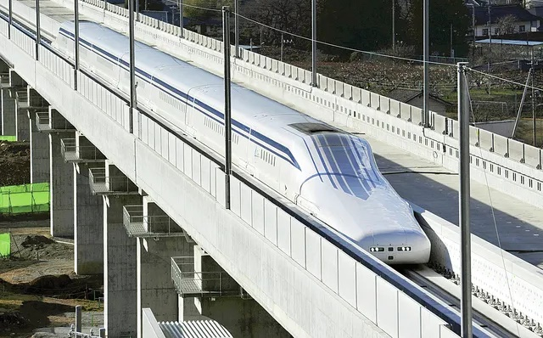
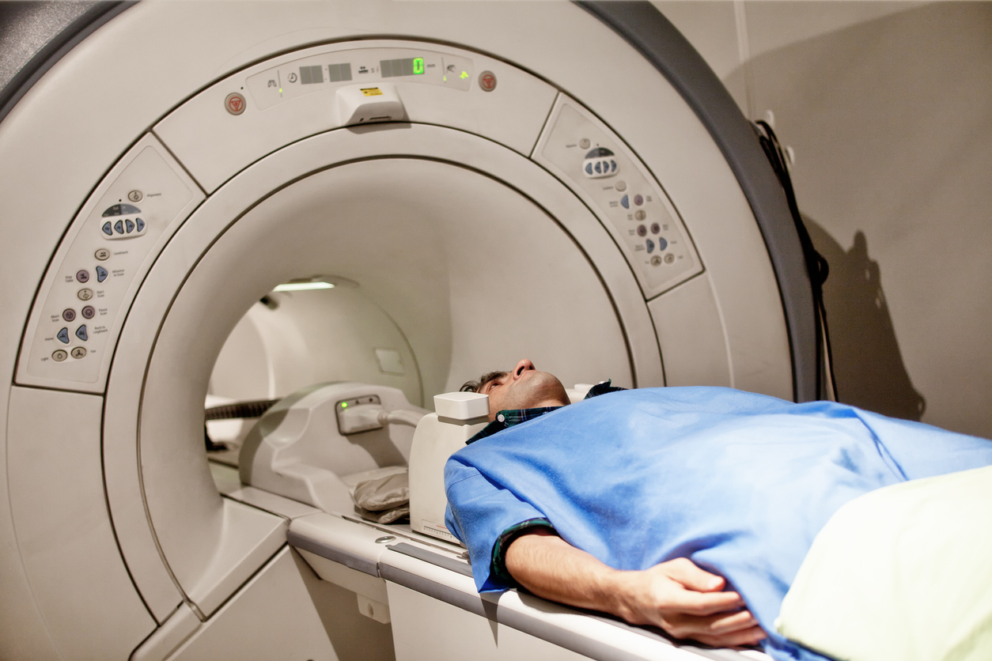
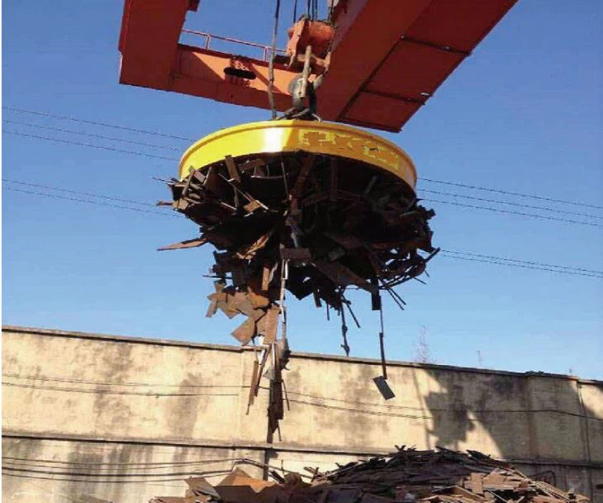
Getting started:
What do these things have in common?
High speed Japanese train
MRI scanner
Scrap yard crane

Slide 2
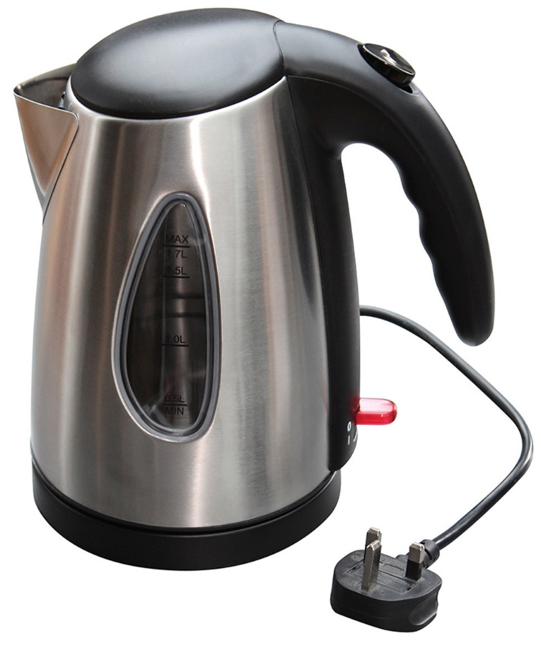

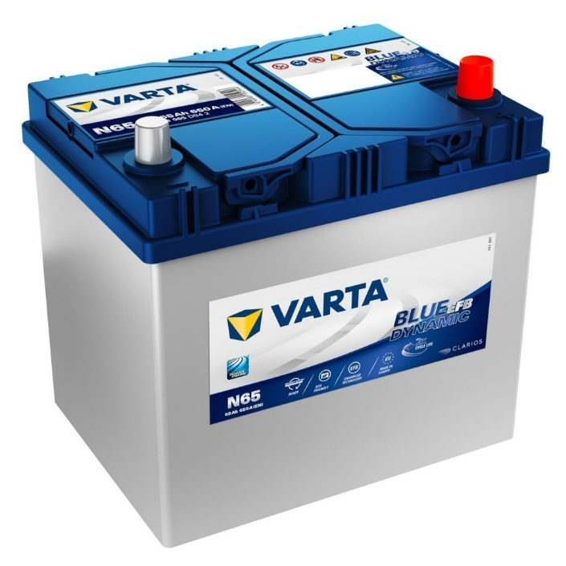
Learning Objective
Understand the relationship between electricity and magnetism
Thermal
Magnetic
Chemical

Slide 3
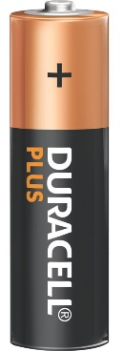
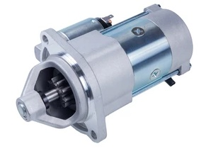
Solenoid
N
S

Slide 4
Solenoid
S
N

Slide 5
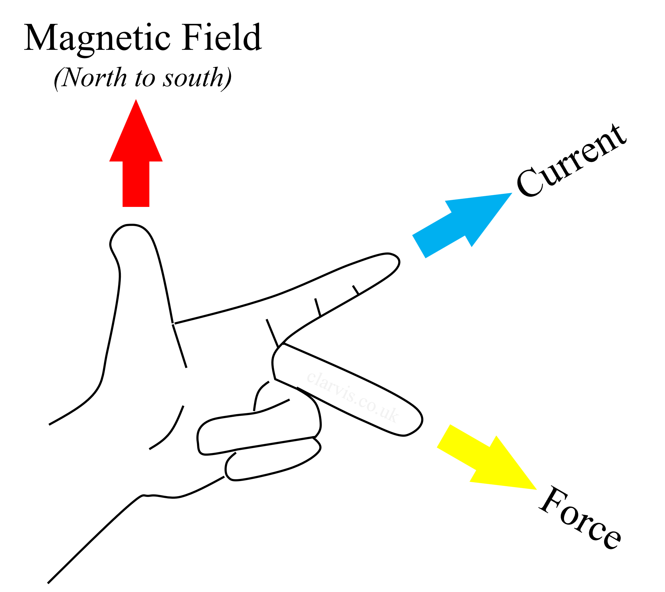
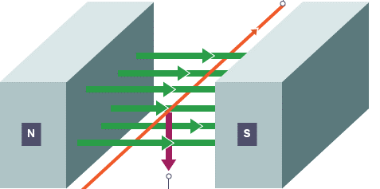
The motor effect
Wire carrying a current
Magnetic field
Direction of force acting on the wire
Flemming’s left-hand rule

Slide 6
The motor effect
Force acting on the wire
(Newtons)
Current flowing through the wire (Amps)
Wire carrying a current
Magnetic field
F = B I L
Magnetic flux density
(Tesla)
Direction of force acting on the wire
Length of the wire (metres)

Slide 7
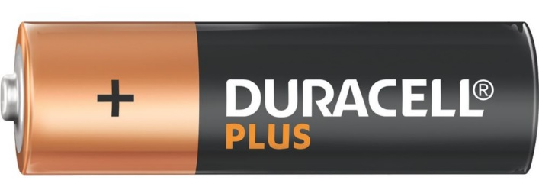
The motor effect
The magnetic field generated by the solenoid interacts with the magnetic field of the permanent magnets, creating a force.
Solenoid formed between either terminal of the battery and the wire.
https://www.youtube.com/watch?v=J9b0J29OzAU

Slide 8

The motor effect – homopolar motor
https://www.youtube.com/watch?v=RGFtpOZxThc&t=116s

Slide 9

The motor effect – homopolar motor
The magnet creates a magnetic field.
The current in the wire creates its own magnetic field perpendicular to the magnet’s.
The two magnetic fields interact producing a force on the wire.
Lorentz Force

Slide 10
Further study
A 0.5 m length of wire carries a current of 2 A. Calculate the force acting on the wire when it is placed at right angles in a 0.4 T magnetic field.
A 5 cm length of wire carries a current of 0.75 A. Calculate the force acting on the wire when it is placed at right angles in a 0.60 T magnetic field.
A 20 cm length of wire is placed at right angles in a 500 mT magnetic field. Calculate the current required to produce a force of 0.08 N.
4. What effect would changing the direction of current flow through the wire?

Slide 11
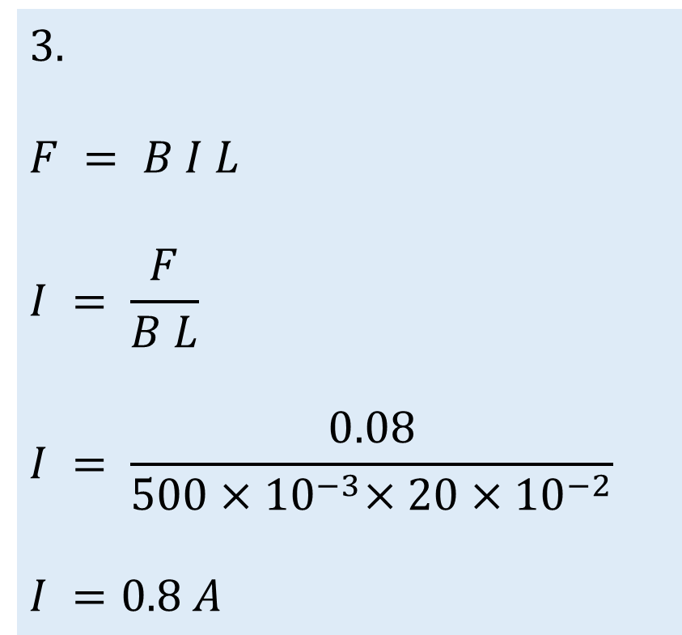
Further study- Answers
1.
F = B I L
F = 0.4 × 2 × 0.5
F = 0.4 N
2.
F = B I L
5 cm = 0.050 m
F = 0.60 × 0.75 × 0.050
F = 0.0225 N
3.
$$F = B I L$$
$$I = \frac{F}{B L}$$
$$I = \frac{0.08}{500{×10}^{−3}{×20×10}^{−2}}$$
$$I =0.8 A$$
4.$The direction of force acting on the wire would be reversed.$

Slide 12
Next in the sequence of lessons, the thermal effects of an electric current would be investigated…

Slide 13
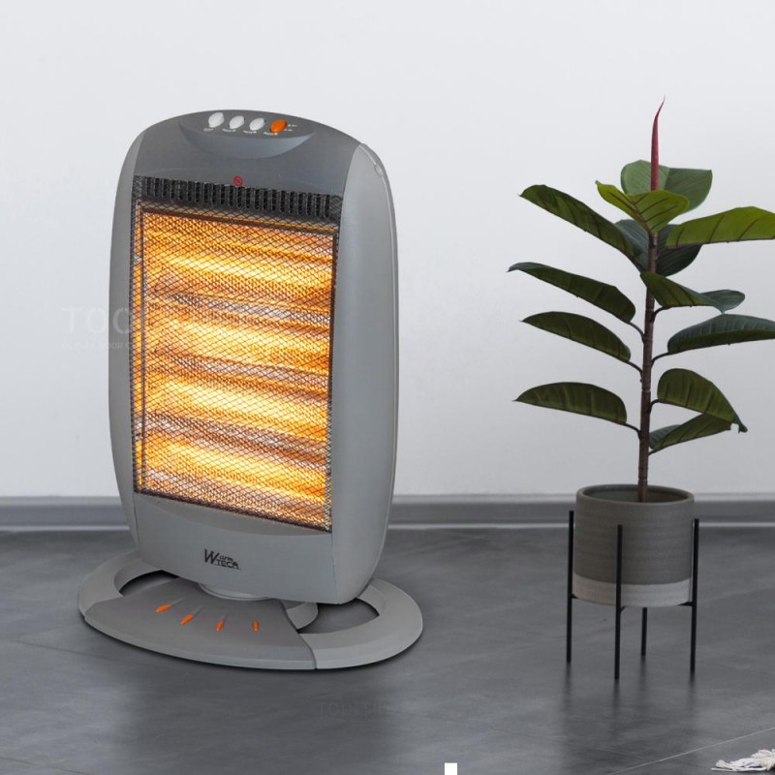
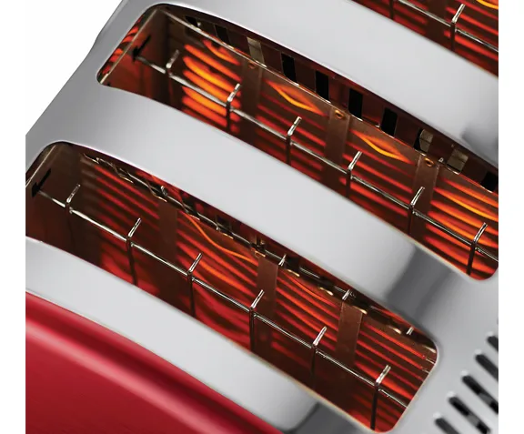
Learning Objective
Know the effects of an electric current
What things do these appliances have in common?
Space heater
Toaster
Kettle

Slide 14
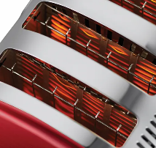
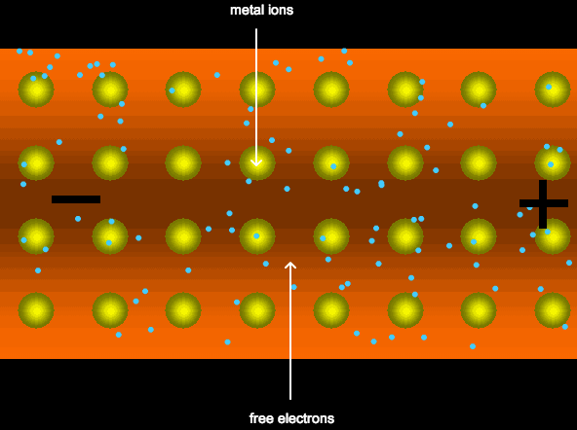
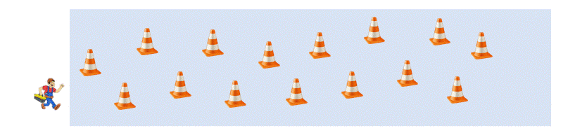
Thermal effect
Why does a wire get hot?
As electrons collide with the metal atoms in a conductor the kinetic force causes heat to be produced.

Slide 15
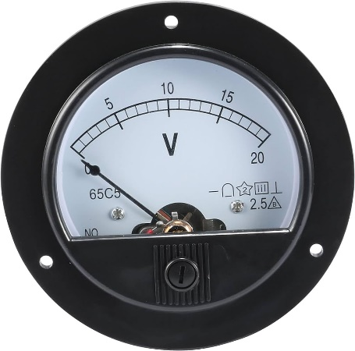
Thermal effect
1
2
4
A
0
8

Slide 16
Thermal effect
1
2
4
A
0
8
1.5V

Slide 17
Thermal effect
1
2
4
A
0
8
3V

Slide 18
Thermal effect
1
2
4
A
0
8
6V

Slide 19
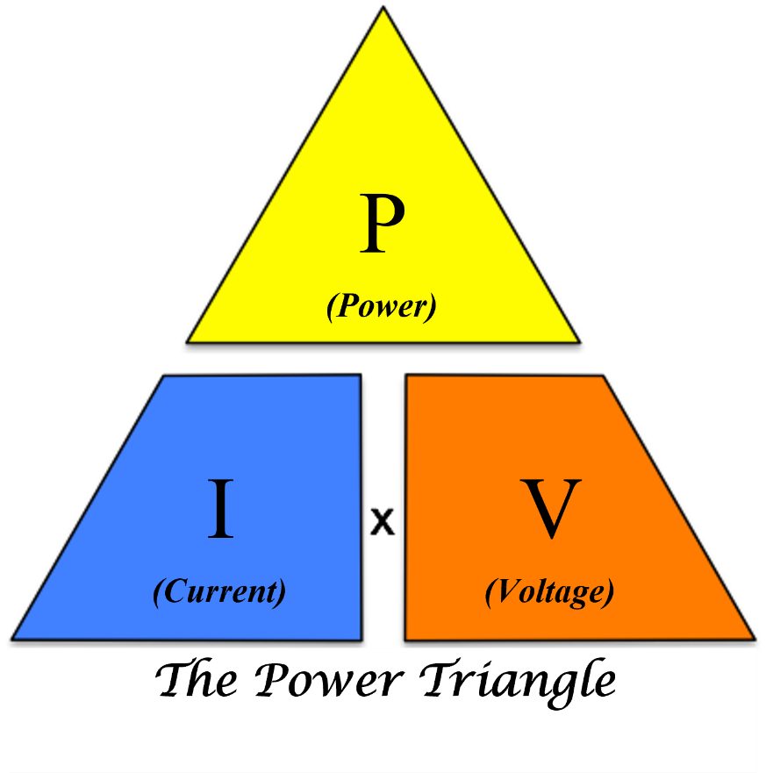
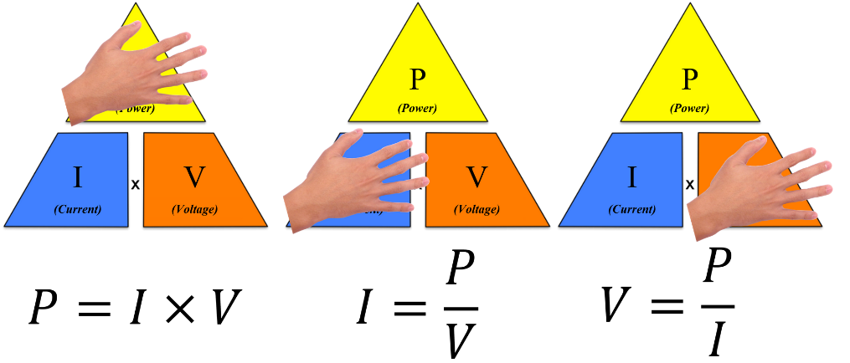
Power
The rate that energy is transferred.
P = I V
Watts

Slide 20
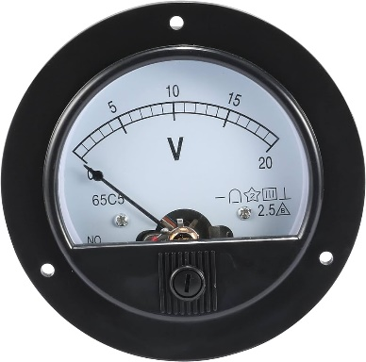

Looking back at our previous circuit
What is the power dissipated by the wire?
?
1
2
4
2A
A
0
8
6V

Slide 21
Looking back at our previous circuit
What is the power dissipated by the wire?
P = I V
P = 2 × 6
P = 12 W
1
2
4
2A
A
0
8
6V

Slide 22
Looking back at our previous circuit
The circuit diagram looks like this
A
V

Slide 23
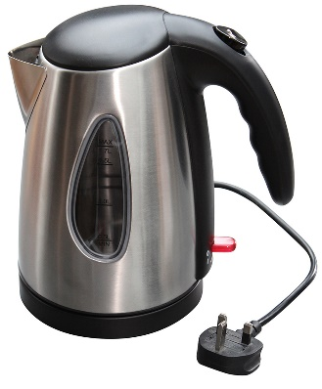
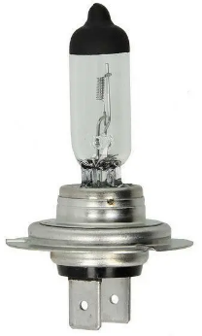
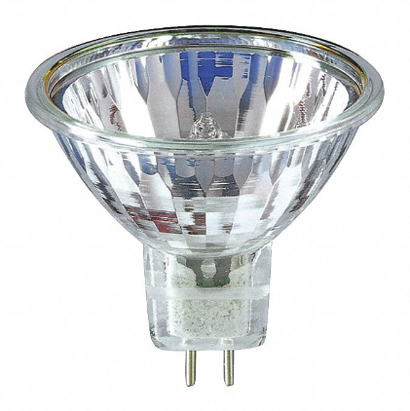
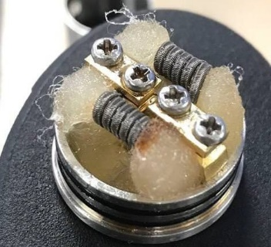
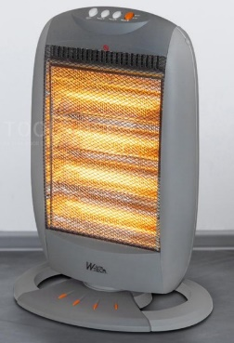
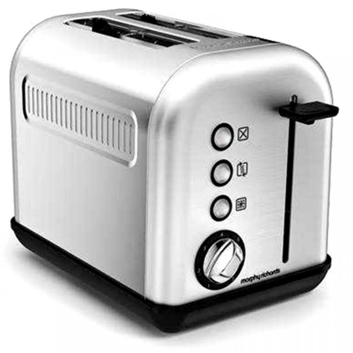
Have a practice
1. This electric kettle draws a current of 10 A from the mains supply (230 V). Calculate the power of the kettle.
4. This is a 55 W car headlight lamp. The battery has a voltage of 12 V. Calculate the current that the lamp draws from the battery.
2. Vapes contain a heating element which evaporates the fluid. If the element draws a current of 10 A from a 3 V battery, what is its power?
5. This 50 W lamp draws a current of 2.1 A from a battery. Calculate what the supply voltage must be.
3. A 1 kW (1000 W) electric space heater is connected to a 230 V supply. What current would it draw from the supply?
6. This 1.5 kW toaster is designed to be used outside the UK. The toaster draws a current of 13.6 A. Calculate what the supply voltage must be.

Slide 24

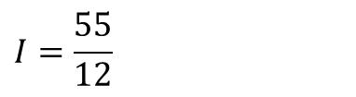
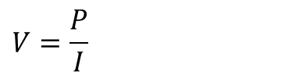


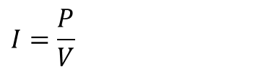


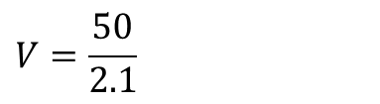

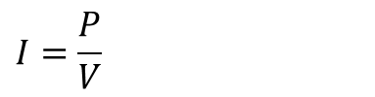


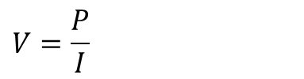
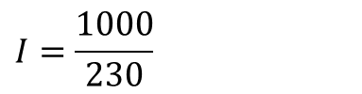
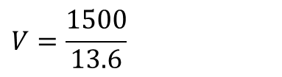



Have a practice - Answers
$$P=IV$$
$$I=\frac{P}{V}$$
$$P=10 ×230$$
$$P=2300 W$$
$$I=\frac{55}{12}$$
$$P=2.3 kW$$
$$I=4.6 A$$
$$V=\frac{P}{I}$$
$$P=IV$$
$$P=10 ×3$$
$$V=\frac{50}{2.1}$$
$$P=30 W$$
$$V=23.8 V$$
$$I=\frac{P}{V}$$
$$V=\frac{P}{I}$$
$$I=\frac{1000}{230}$$
$$V=\frac{1500}{13.6}$$
$$I=4.3 A$$
$$V=110.3 V$$

Slide 25
Thermal effect

